Slide 1
Project Review – 2 Lane Following Mobile Robot

Slide 2

Lane Following Mobile Robot
Department of Electronics Engineering
Team Members
Chinmay Bhoir (TU1F1819006)
Mahendra Gudla (TU1F1819009)
Suchita Boga (TU1S1920004)
Sandhya Yadav (TU1S1920008)
Project Guide : Project Coordinator :
Mr. Vijaykumar Chaudhari Mrs. Renuka Chimankare

Slide 3
Contents
Abstract
Introduction
Literature Review
Methodology
Hardware & Software Requirements
Expected Through & Conclusion
Advantages & Disadvantages
Applications
References

Slide 4
Abstract
In present time, many different technologies are used for autonomous driving of robot and safety of autonomous vehicle .The purpose of this project is by using current technology to design fully functional product for autonomous driving.
The main objective of Lane Following Mobile Robot is to drive autonomous robot between two parallel lines. This can be achieve by using a camera. The visibility of the lane information is checked by the lane width constraints and its parallel property.
In this project, lane is recognized by vision based and 3D LiDAR and GSM for safety of mobile robot. In this current time ,many technologies are used for safety of vehicle. In that 3D Lidar is used for finding the distance between the vehicle and obstacles by emitting pulse light waves into the surrounding environment and this obstacles information is then send by GSM to the user.

Slide 5
Introduction
The Goal of our project is to design a fully automated and functional product that is used for field of vehicle safety system by using Advance safety vehicle and also used in automated industry.
In this project we will be using 3D LiDAR, Camera and GSM system. Camera is used to detect the lane and 3D LiDAR is used for finding the distance between obstacle and vehicle. GSM is used for sending the message to owner or user.
The Main scope of our project is to track lane and to protect the vehicle.

Slide 6
 | Paper - 1 | Paper - 2
Title | Motion Control of a 4WS4WD Path-Following Vehicle: Dynamic Based Steering and Driving Models. | Real-Time Road Lane Detection in Urban Areas Using LiDAR Data.
Authors Name | Zhonghua Zhang ,Caijin Yang,Weihua Zhang,Yanhai Xu,Yiqiang Peng and MaoruChi | Jiyoung Jung and Sung-Ho Bae
Publish Date | 2021 | 2018
Key Parameters | Fuzzy Logic for Path following | 3D – Lidar used for Lane Detection
What We Learned | Path following includes with new functions like Fuzzy logic which made the controller more robust and flexible | We learned how 3D- LiDAR monitors the distance between vehicles that are in side way

Slide 7
Working
In this project we are going to use 3D LiDAR, Camera and GSM system. All these systems are attached to the vehicle.
The Camera is used for the detecting the lane and 3D LiDAR is used for measuring the distance between the vehicle and obstacle and other vehicles. When the distance between the obstacle and other vehicles is less, then the controller sends the signal to GSM and then GSM sends the message to the user or owner and also controls the vehicle according to the situation.
When the vehicle goes out of path then also GSM sends the message and controls the vehicle according to the situation. All these situations are controlled by Controller.
We use GSM because when the vehicle is not able to control the situation then the user can send the signal to the controller using GSM.
According to this, we can design the lane detecting robot with safety of robot.

Slide 8
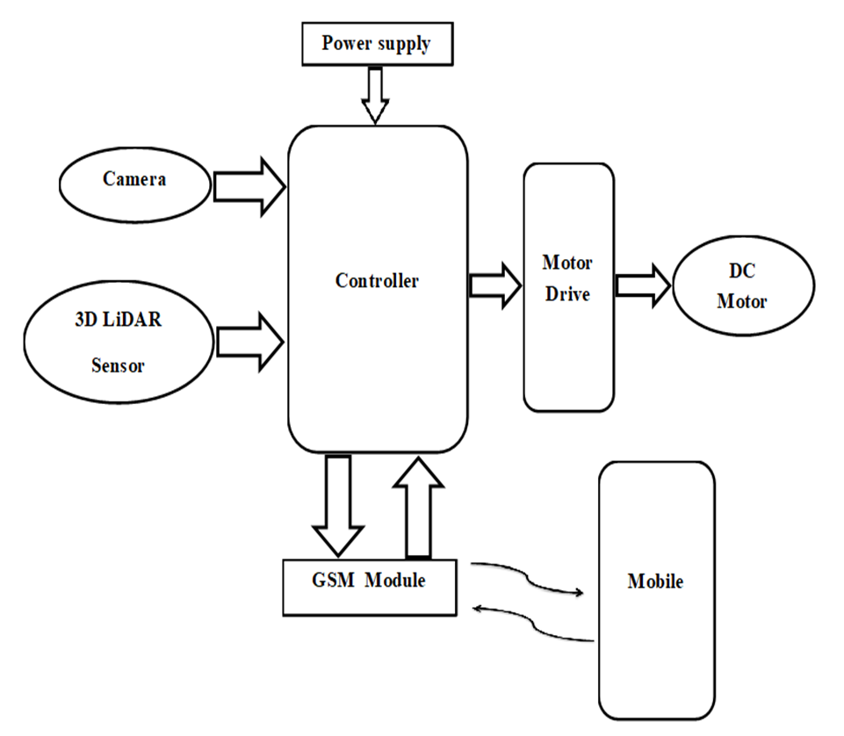
Methodology block diagram

Slide 9
Hardware & Software Requirement
Hardware Requirements
Raspberry Pi 3 (Model B)
Raspberry Pi 5 Megapixels Camera Model
3D – LiDAR Sensor
DC Motors
Power Supply
GSM Module
Software Requirements
C Programming
Java and XML (For Android Application)
SQLite (Database)

Slide 10
Advantages
Fit and Forget System
Used for long distance applications
Increased flexibility
Increased safety
Quick implementation
Ability to scale
Easy to move between facilities

Slide 11
Disadvantages
Slow speed and instability on different line thickness and angles.
Limitations on load size.
Determining the correct path.

Slide 12
Applications
This project can be used in driverless car system with some added features like obstacle detection, etc.
It can be used in industries to carry loads.
It can also be used in defense for war purpose.
In hotels, they can be used for the transfer of things from one place to another following the lane.

Slide 13
Future Scope & Conclusion
The project specifies an automated Lane detection system. The system with all parameters like detecting the edge points, mapping a line and accordingly changes the direction.
In future, this model can be fully-automated using new comprehensive control methods and new technology that would be introduced further.

Slide 14
References
[1] Motion Control of a 4WS4WD Path-Following Vehicle: Dynamic Based Steering and Driving Models.
Authors : Zhonghua Zhang ,Caijin Yang ,Weihua Zhang,Yanhai Xu,Yiqiang Peng and Maoru Chi
Published: 2021
Available :
https://www.hindawi.com/journals/sv/2021/8861159/
[2] Real-Time Road Lane Detection in Urban Areas Using LiDAR Data
Authors : Jiyoung Jung and Sung-Ho Bae
Published: 2018
Available :
https://www.semanticscholar.org/paper/A-lane-detection-method-based-on-3D-LiDAR-Wang-Tsai/e6daa6d319947e660b7c0279ff358ebb5ff360b6

Slide 15
Thank You

